Slide 1

TASK 2 SCHEMATICS OF COMPONENTS
GROUP 10
BINDU

Slide 2

INSTALLATION OF easyEDA
After downloading the easyEDA software from official site.
The ubuntu commands to install is – >> cd Downloads/
>> sudo chmod + x easyEda(apk name) , this command will make this file excutable.
>>Sudo Unzip easyEda (apk full name) , this command will unzip the zip file of easyEDA
>>sudo bash install.sh , this command is to excute install.sh file to successful installation

Slide 3
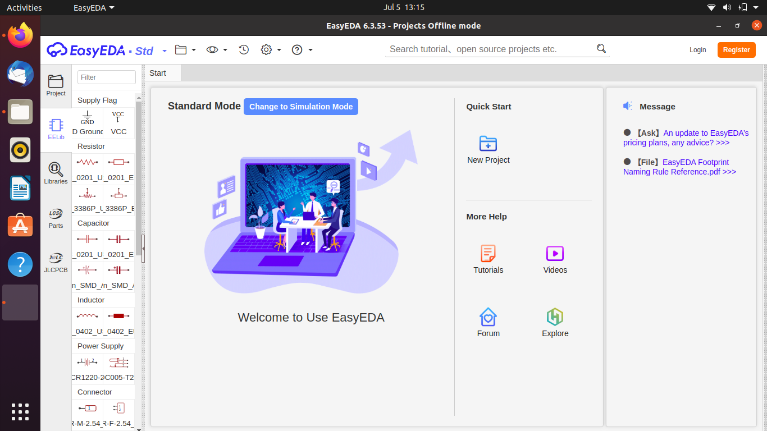
HOMEPAGE OF SOFTWARE

Slide 4
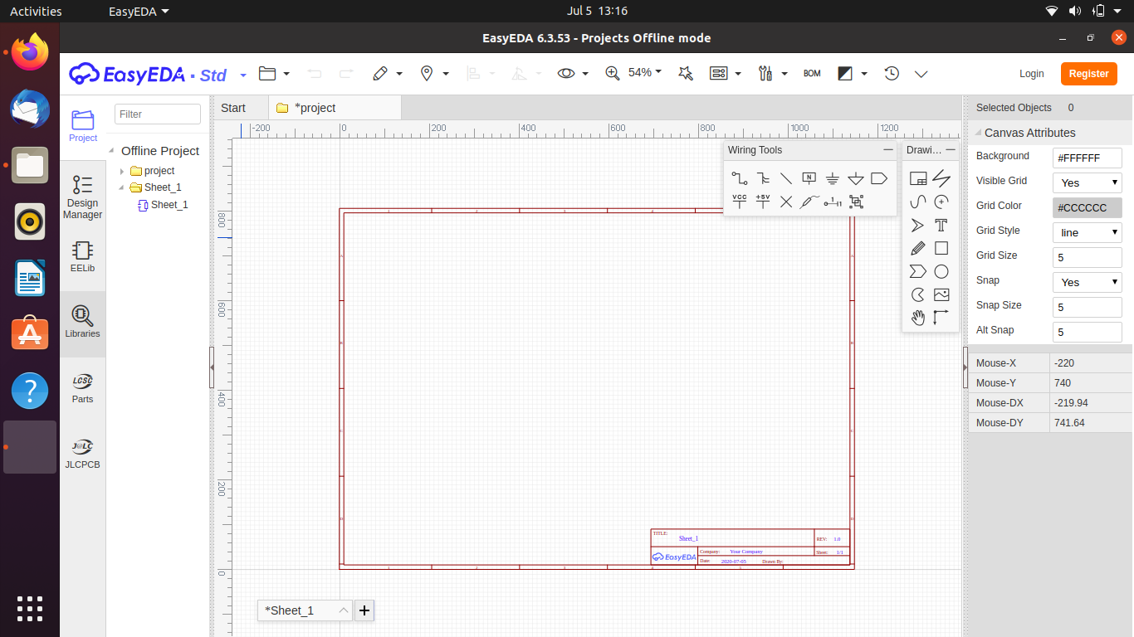
We will use wiring tools and libraries from this screen. Go to Libraries on left side of screen

Slide 5
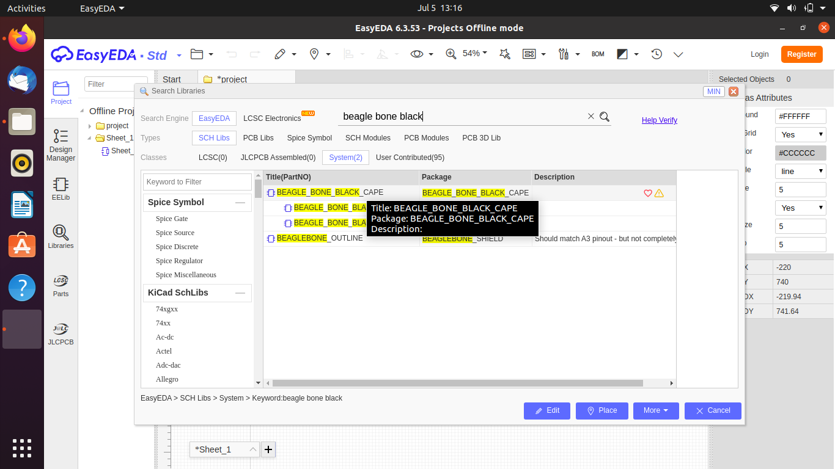
We can search for our modules on this search libraries box.
It has all the required modules we are using in our projects except the wifi usb module so we have used alternatives of that.

Slide 6
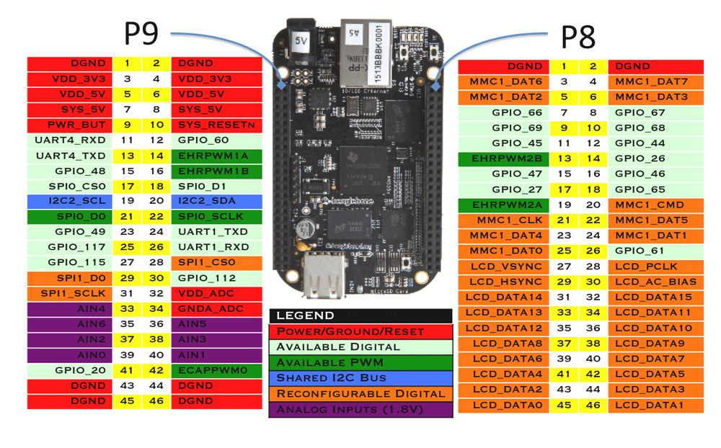
PINOUT OF BEAGLE BONE BLACK mostly we will use pins of p9 header as it has i2c and uart pins on it.

Slide 7
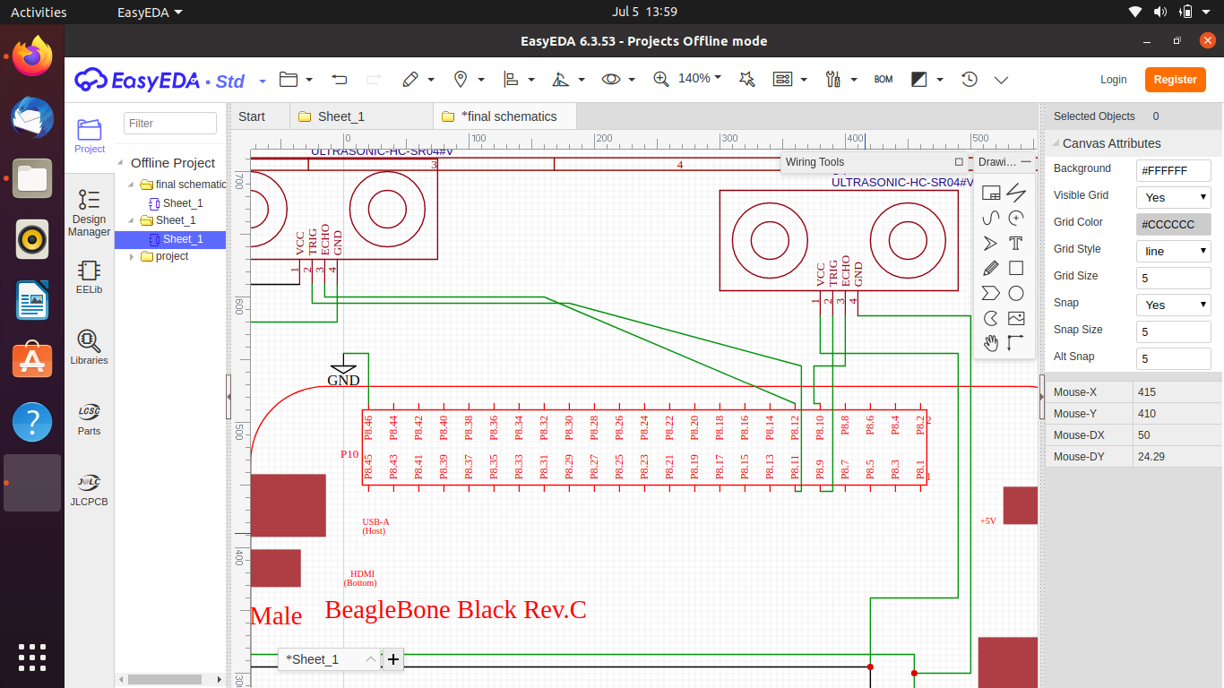
Interface of sensors with Beagle bone the TRIG is connected to p8_11 and p8_9 and ECHO is connected to p8_10 and p8_12. The vcc and grd is coonected to p9 header vcc and ground.

Slide 8
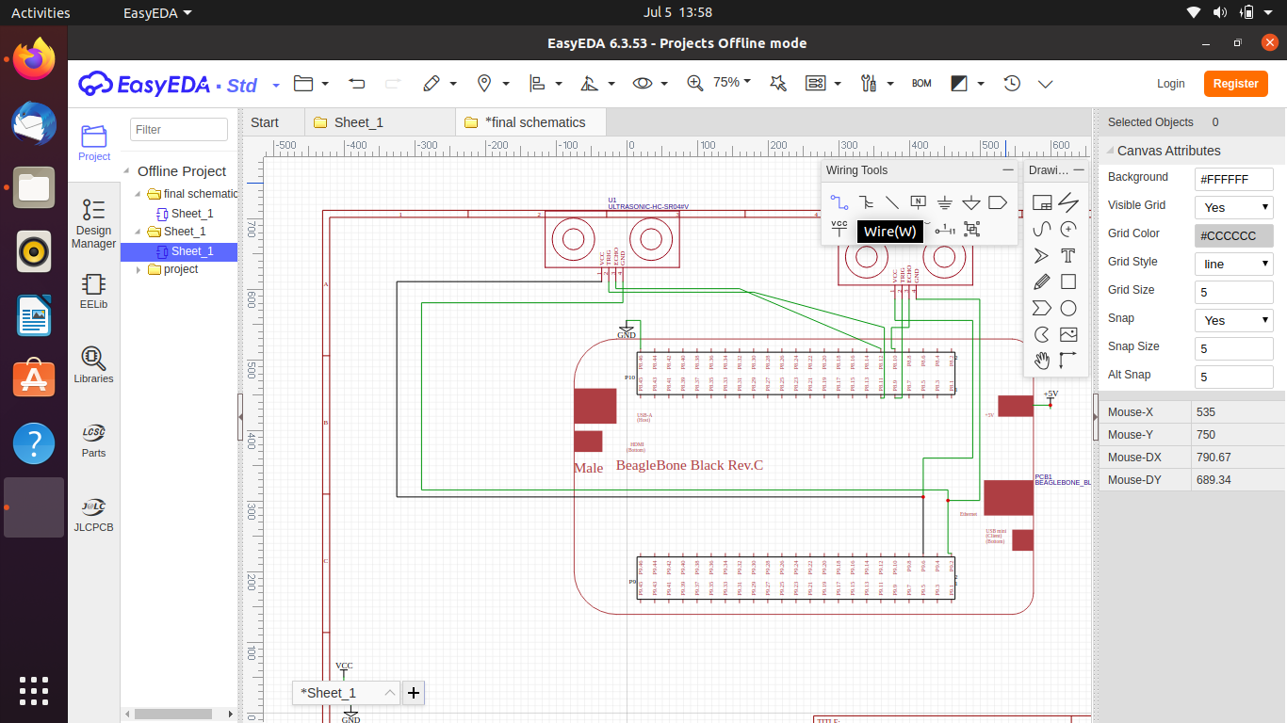
The VCC and Ground of both sensors are connected to output power supply of beaglebone at p9 header

Slide 9
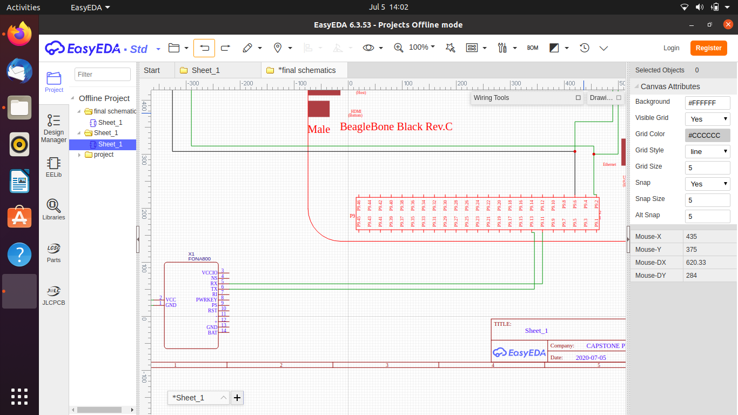
Interface of GSM module Fona 800

Slide 10
The rx pin of gsm module is connected to uart4_tx pin_11 at p9 header and TX is at uart4_rx pin_13. it proves the uart interface.

Slide 11
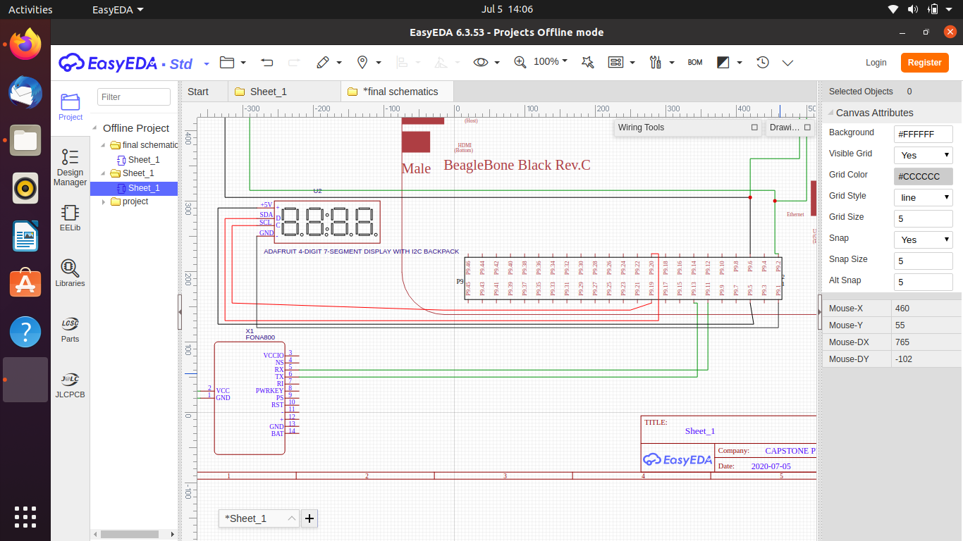
4-Digit 7 Segment Display with I2c interface
The i2c2_SDA pin of p9 header is connected to SDA of display, the i2c2_SCL pin of p9 header of bbb to SCl pin of display. The display will be powered from beaglebone pins at the same p9 header. pin 5 and pin 1

Slide 12
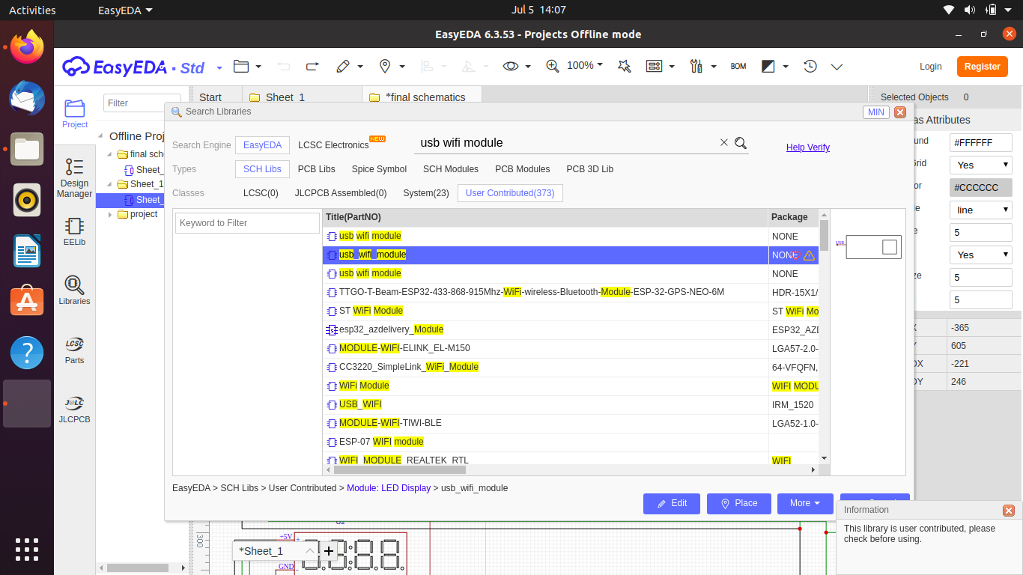
Wifi module interfacing using USB port
There is only one kind of usb wifi module in easyEda. We can’t find the libraries for Adafruit wifi dongle.

Slide 13
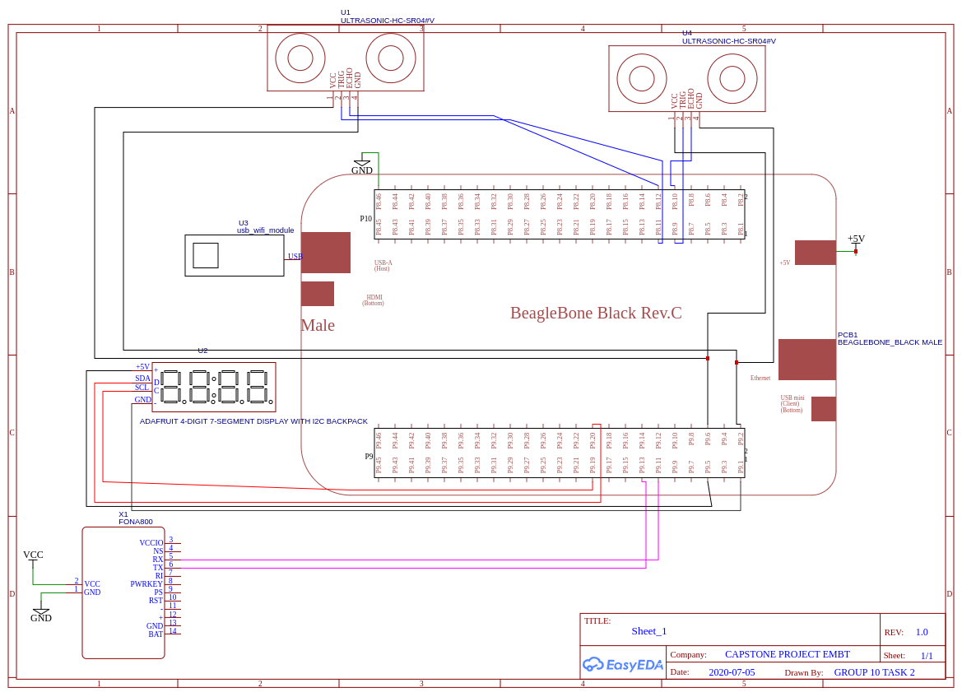
The usb wifi module is connected at the USB A port of beagle bone.

Slide 14
FINAL SCHEMATICS

Slide 15
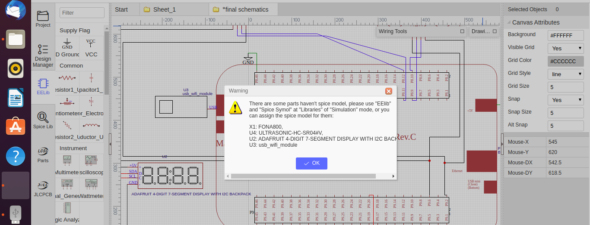

SIMULATION OF PROJECT
The simulation of Beagle bone black is not possible in easyEda software because for this we need components in “EElib” and “ Spice symbols” which is not available in easyEDA software.

Slide 16
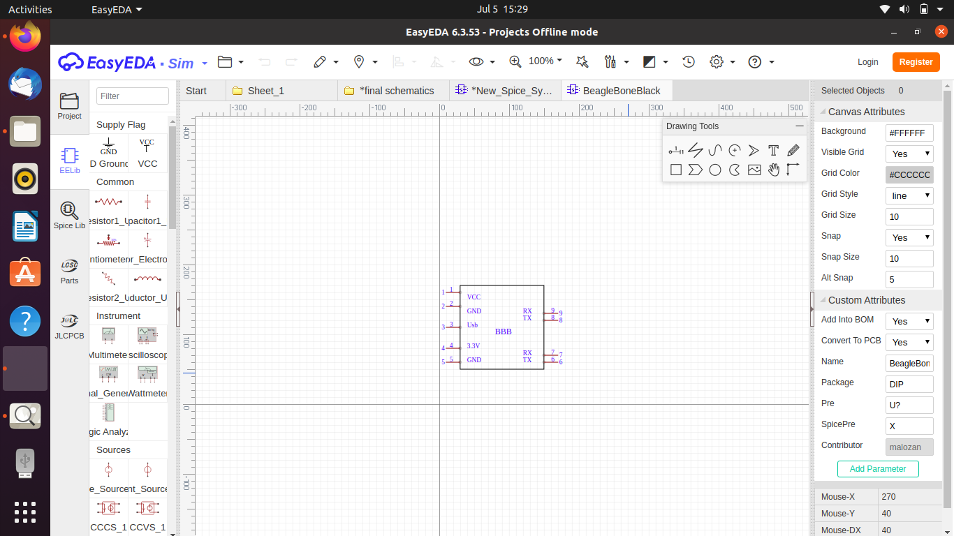
This is the only beagle bone black model in spice library , which is not suitable for our schematics. It does not have i2c , and other required gpio pins. Also there is no libraries for other components so simulation is not possible in easyEda.

Slide 17
REFERENCES
components101. (n.d.). Retrieved from BeagleBone Black:
https://components101.com/microcontrollers/beaglebone-black-pinout-datasheet
easyEDA. (n.d.). Retrieved from Schematic Modules:
https://easyeda.com/modules?docType=schematic

